Slide 1
Adding a Shipper in ConnectShip
By: Kevin Arellano

Slide 2
Progistics Management Console
Open the “Progistics Management Console” by clicking the “Start Menu” icon located in the lower right of the screen.
Click the encircled downward arrow near the bottom left.

Slide 3
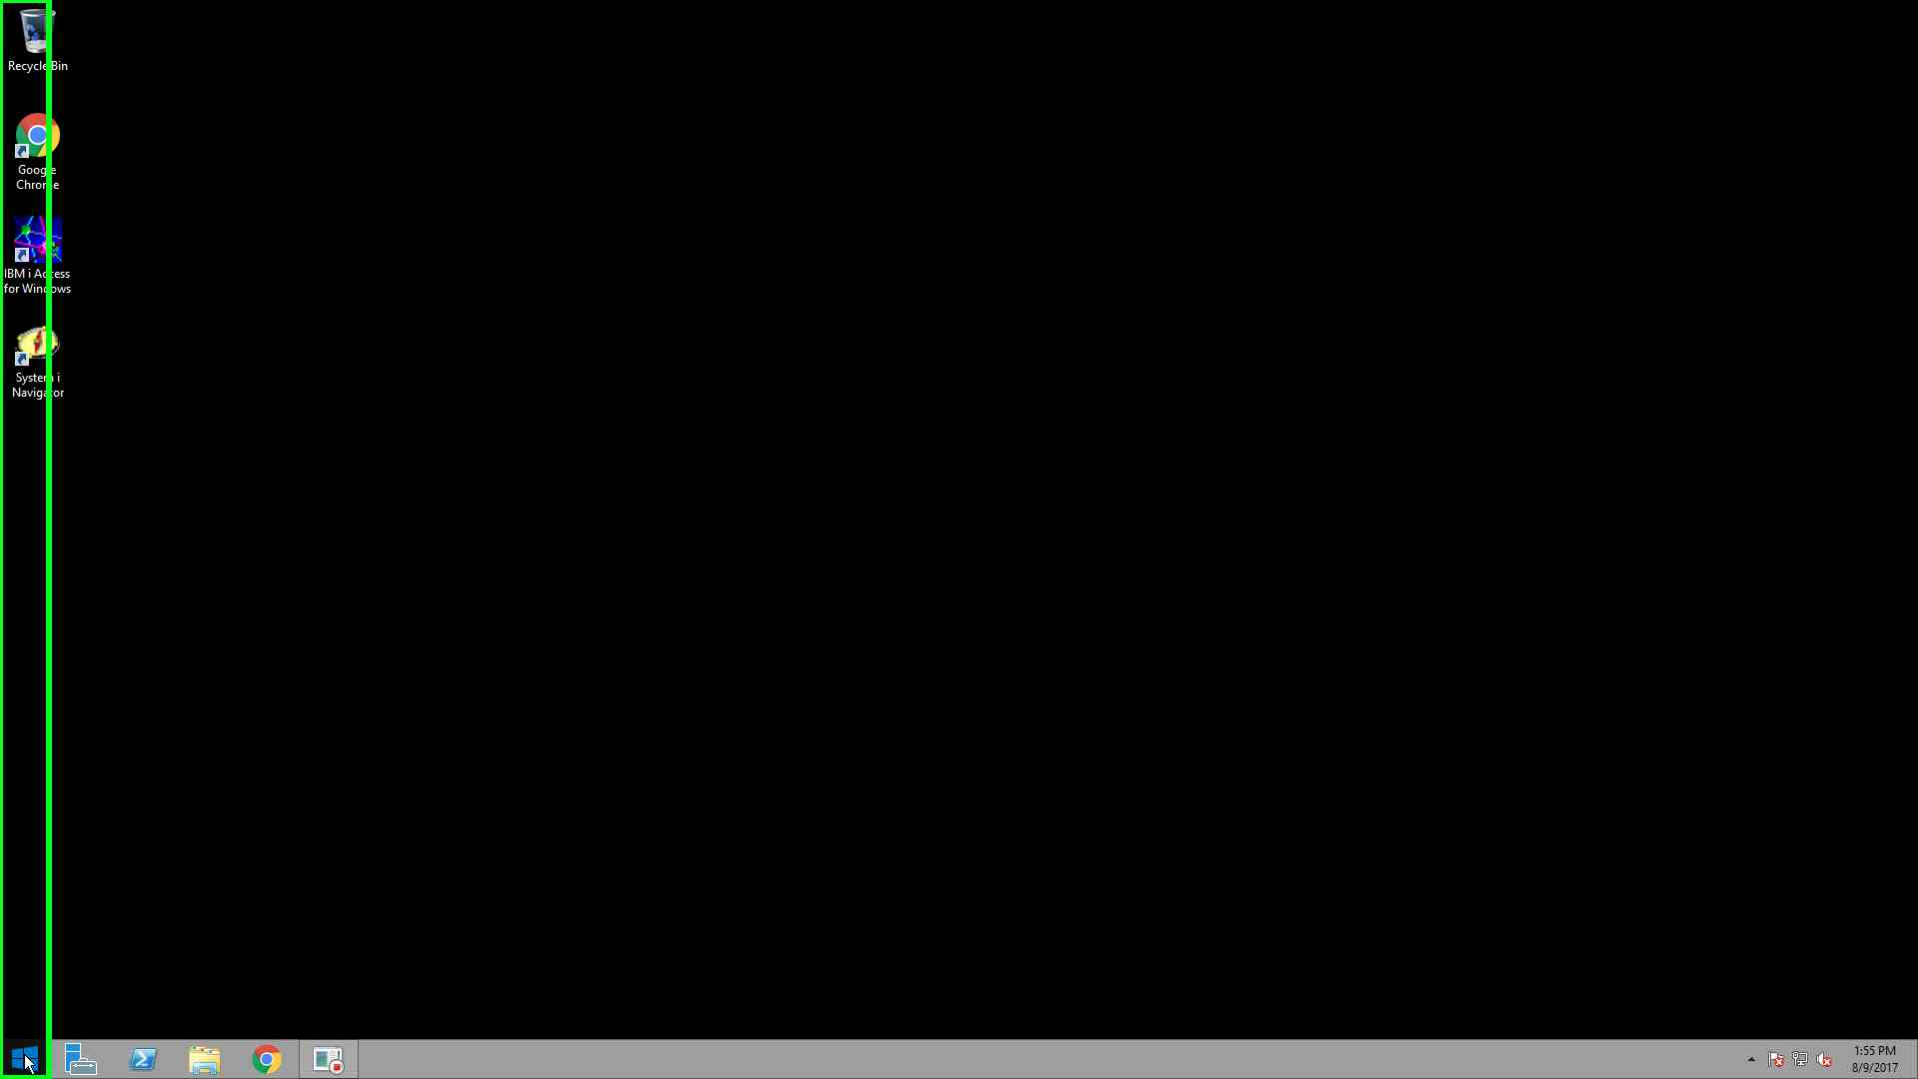

Slide 4
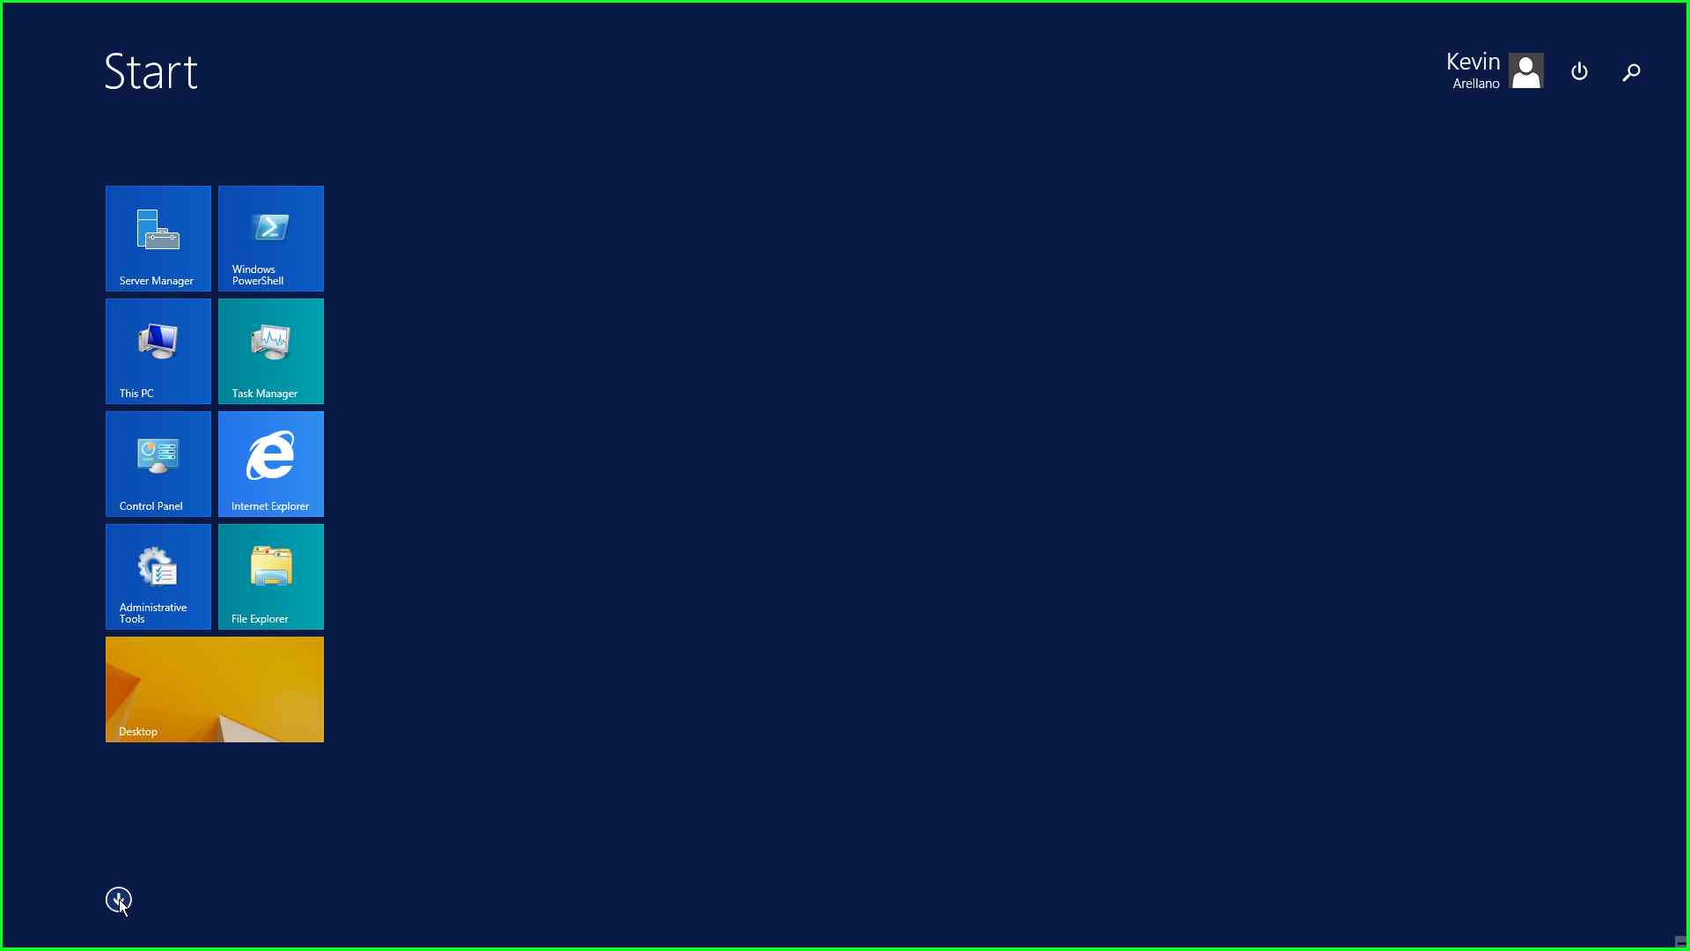

Slide 5
Progistics Management Console
Right click on “Progistics Management Console”.
Select “Run as administrator”.

Slide 6
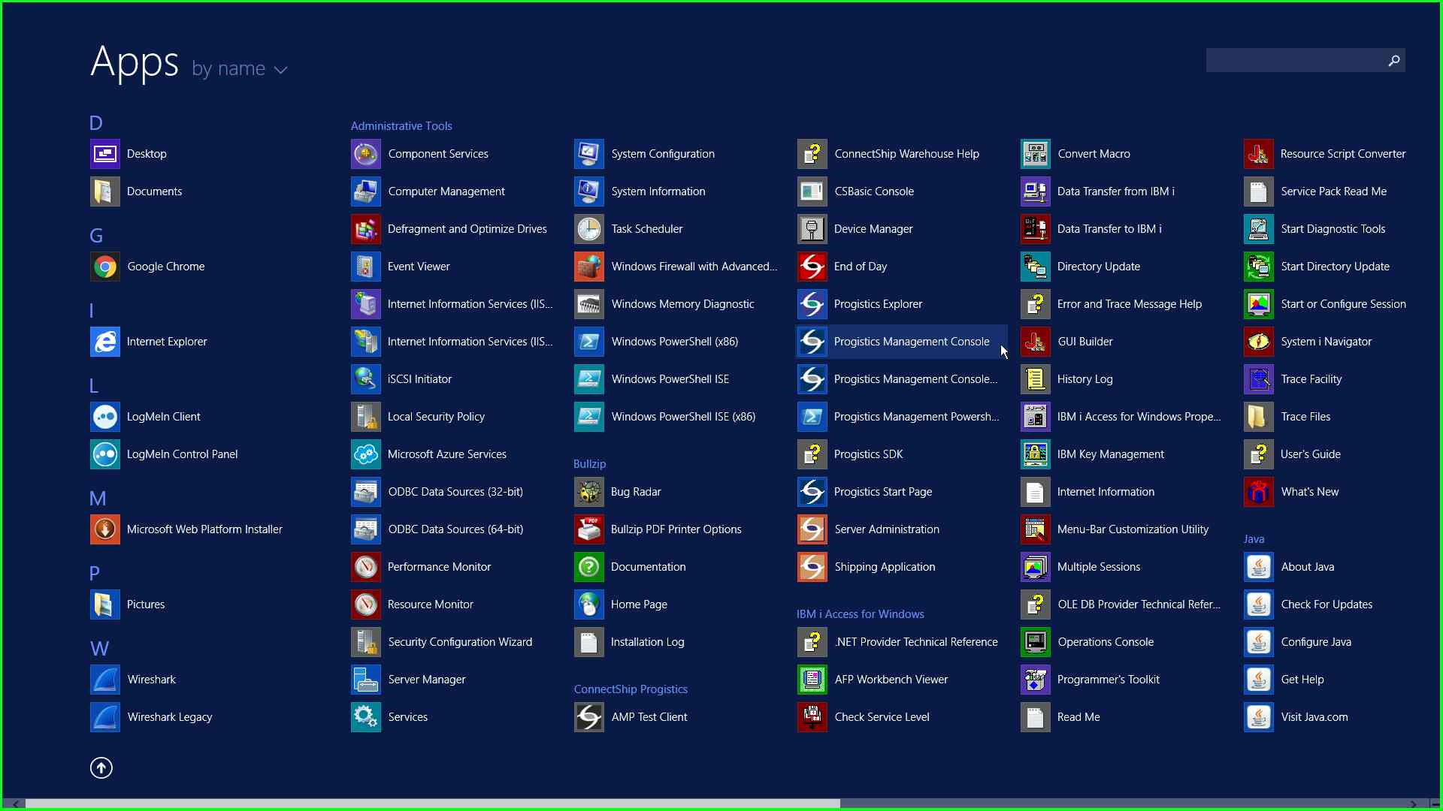

Slide 7
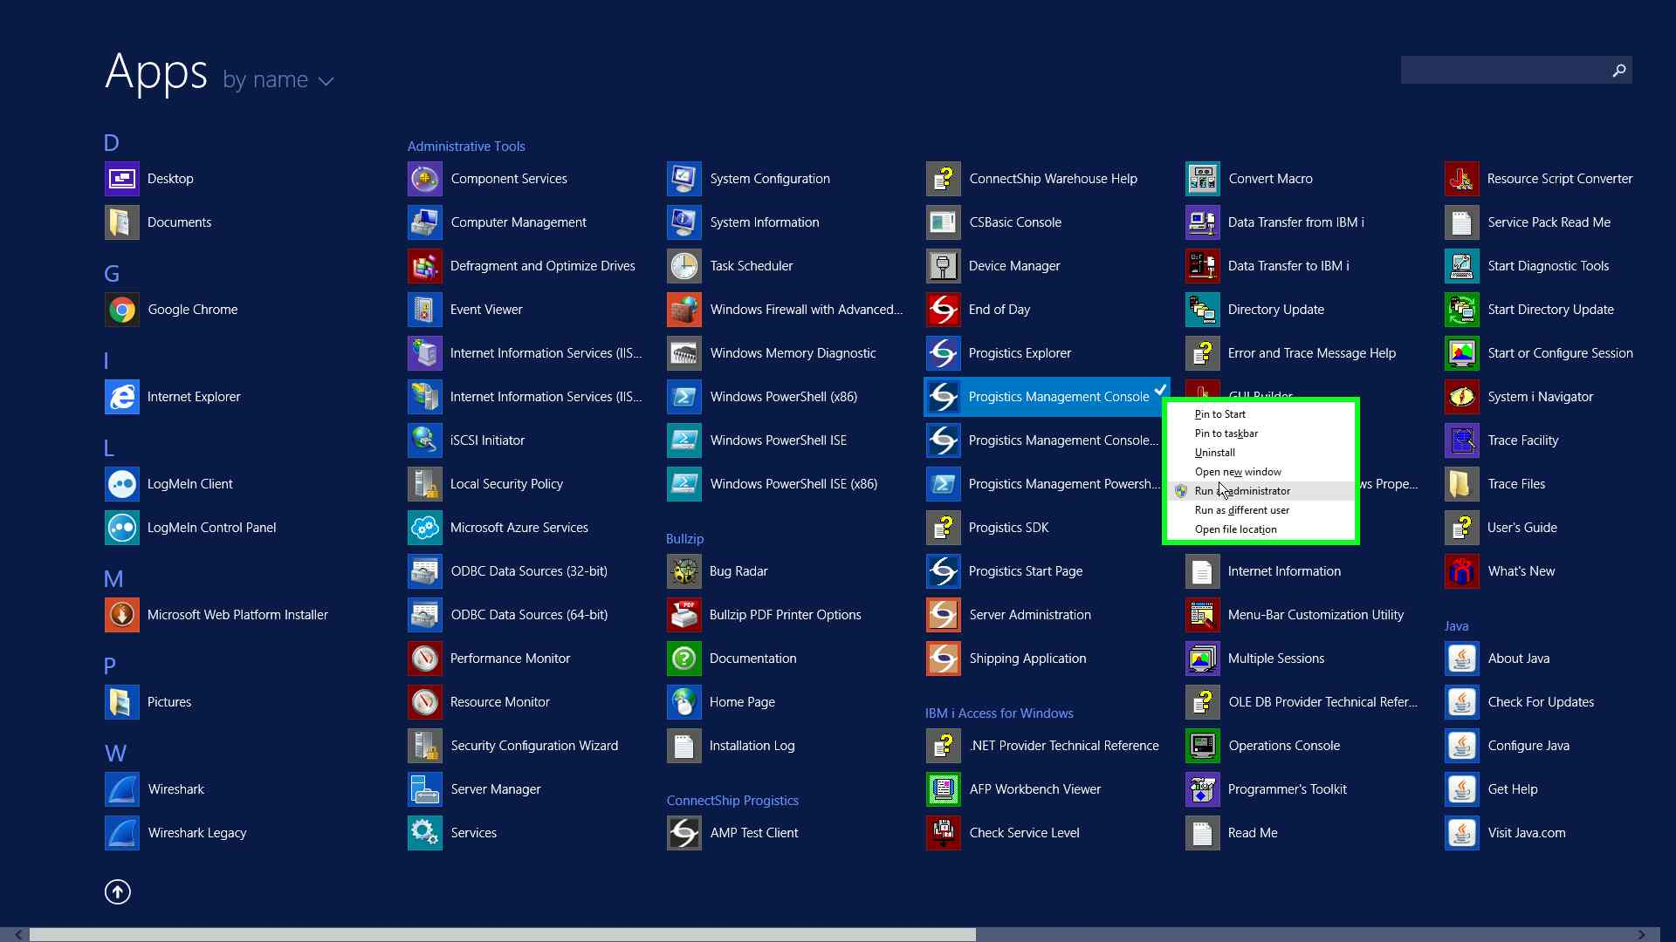

Slide 8
Progistics Management Console
Click on “Shipper Configuration” in the left hand menu.
Click on the “Add Shipper...” button.

Slide 9
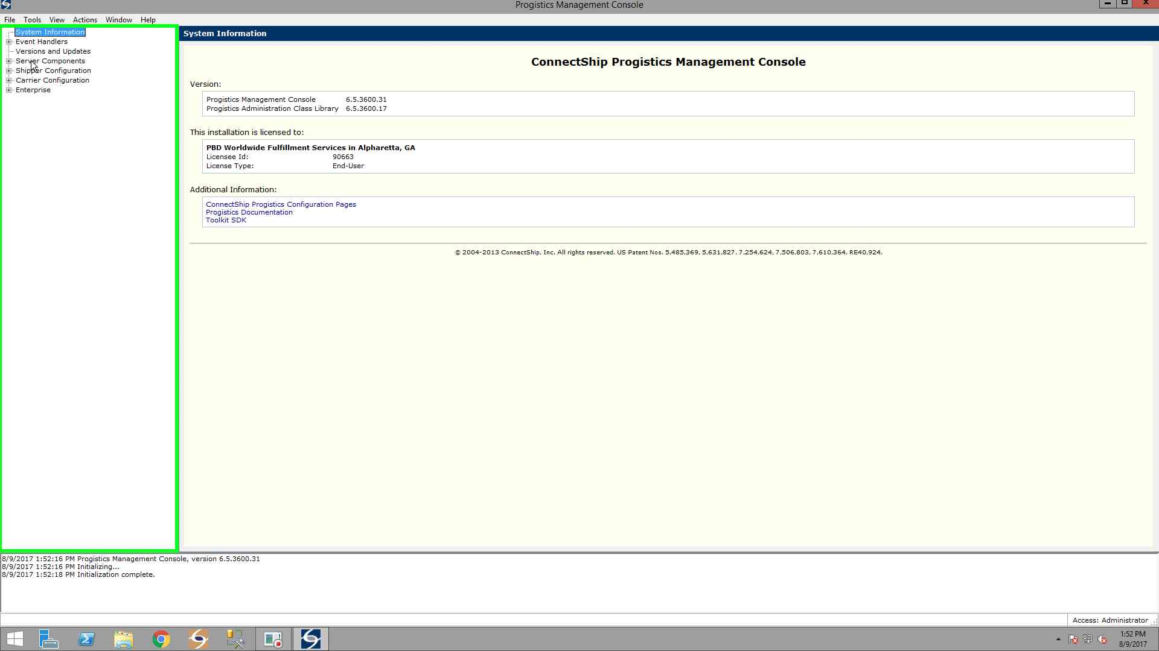

Slide 10
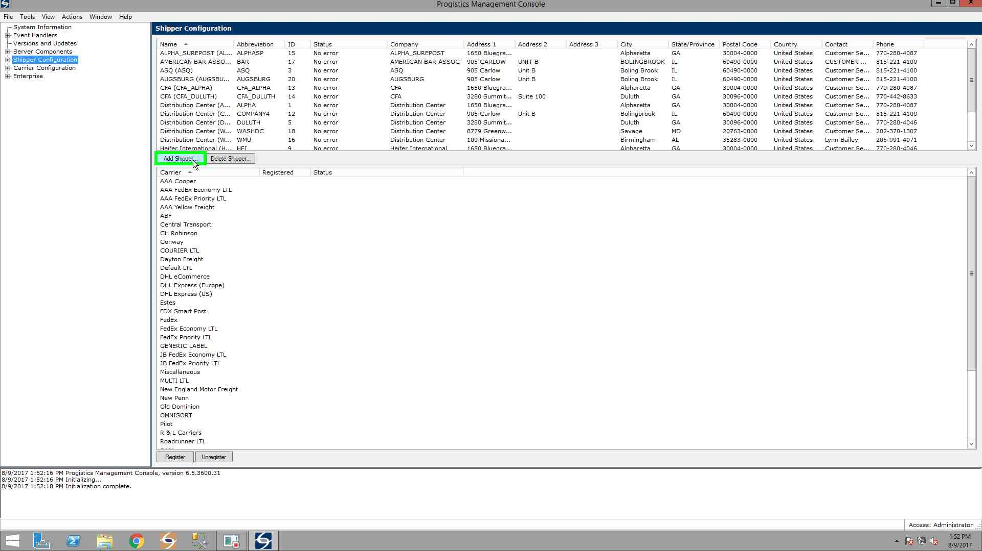

Slide 11
Progistics Management Console
Add the appropriate data in each field.
Click the “Ok” button.

Slide 12
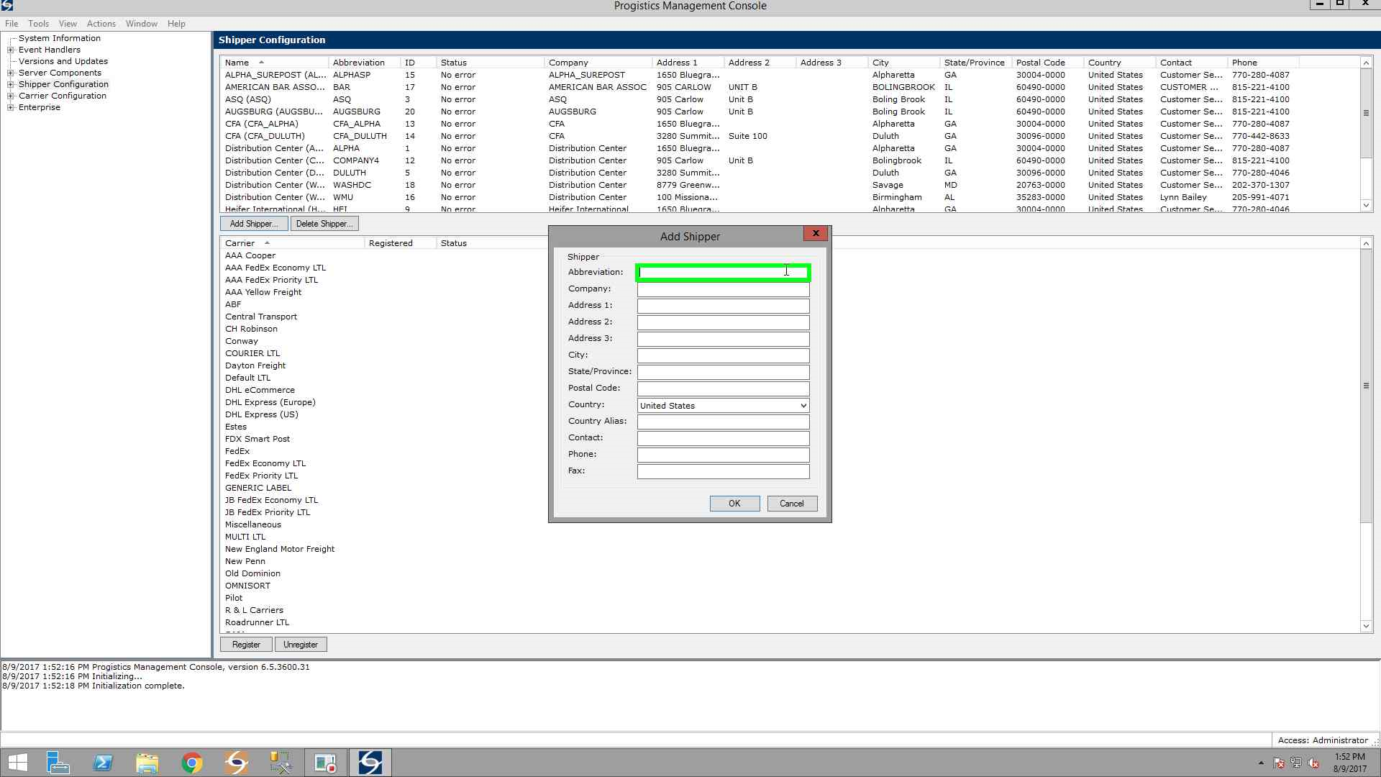

Slide 13
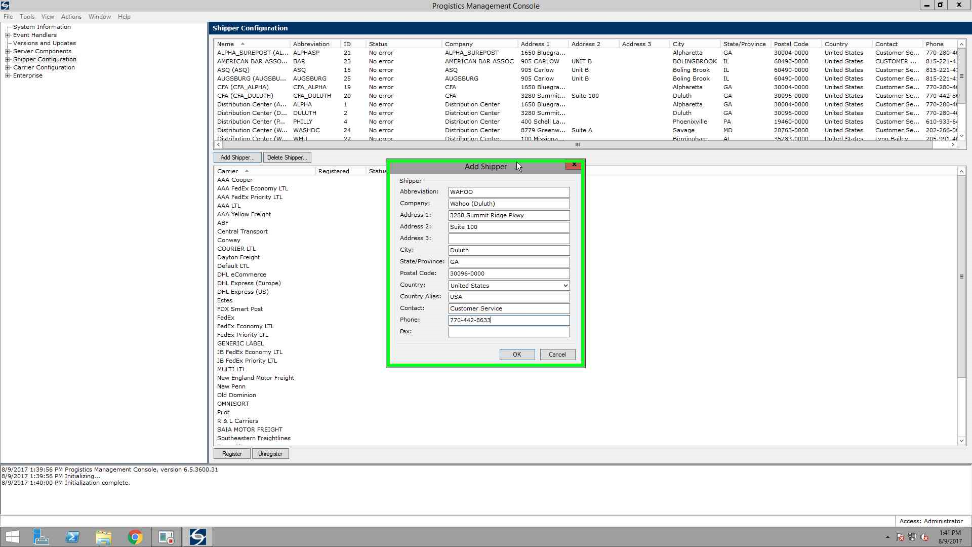

Slide 14
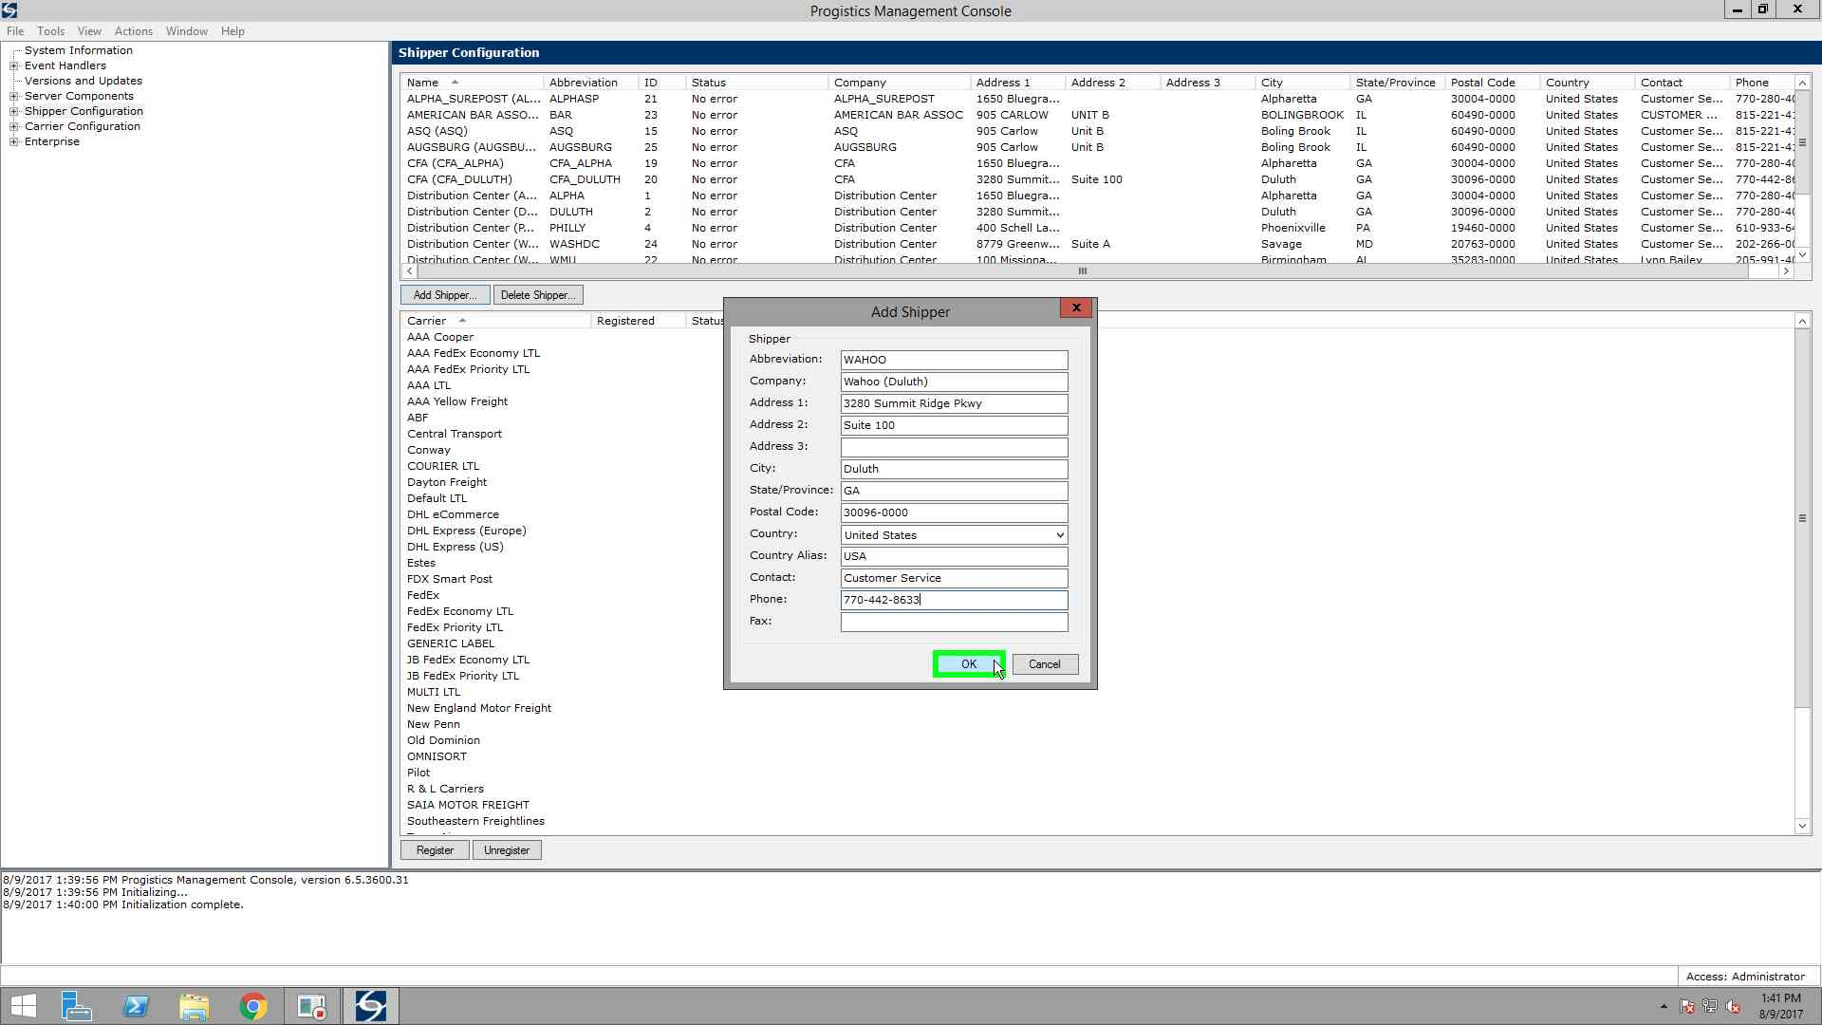

Slide 15
Progistics Management Console
Add the appropriate data in each field.
Click the “Ok” button.

Slide 16
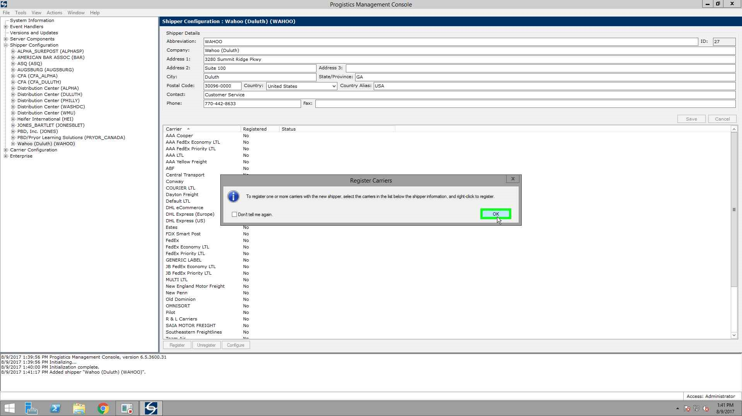

Slide 17
ConnectShip Warehouse Shipping Application
Check in the “ConnectShip Warehouse Shipping Application” to see if the Shipper was added successfully.

Slide 18
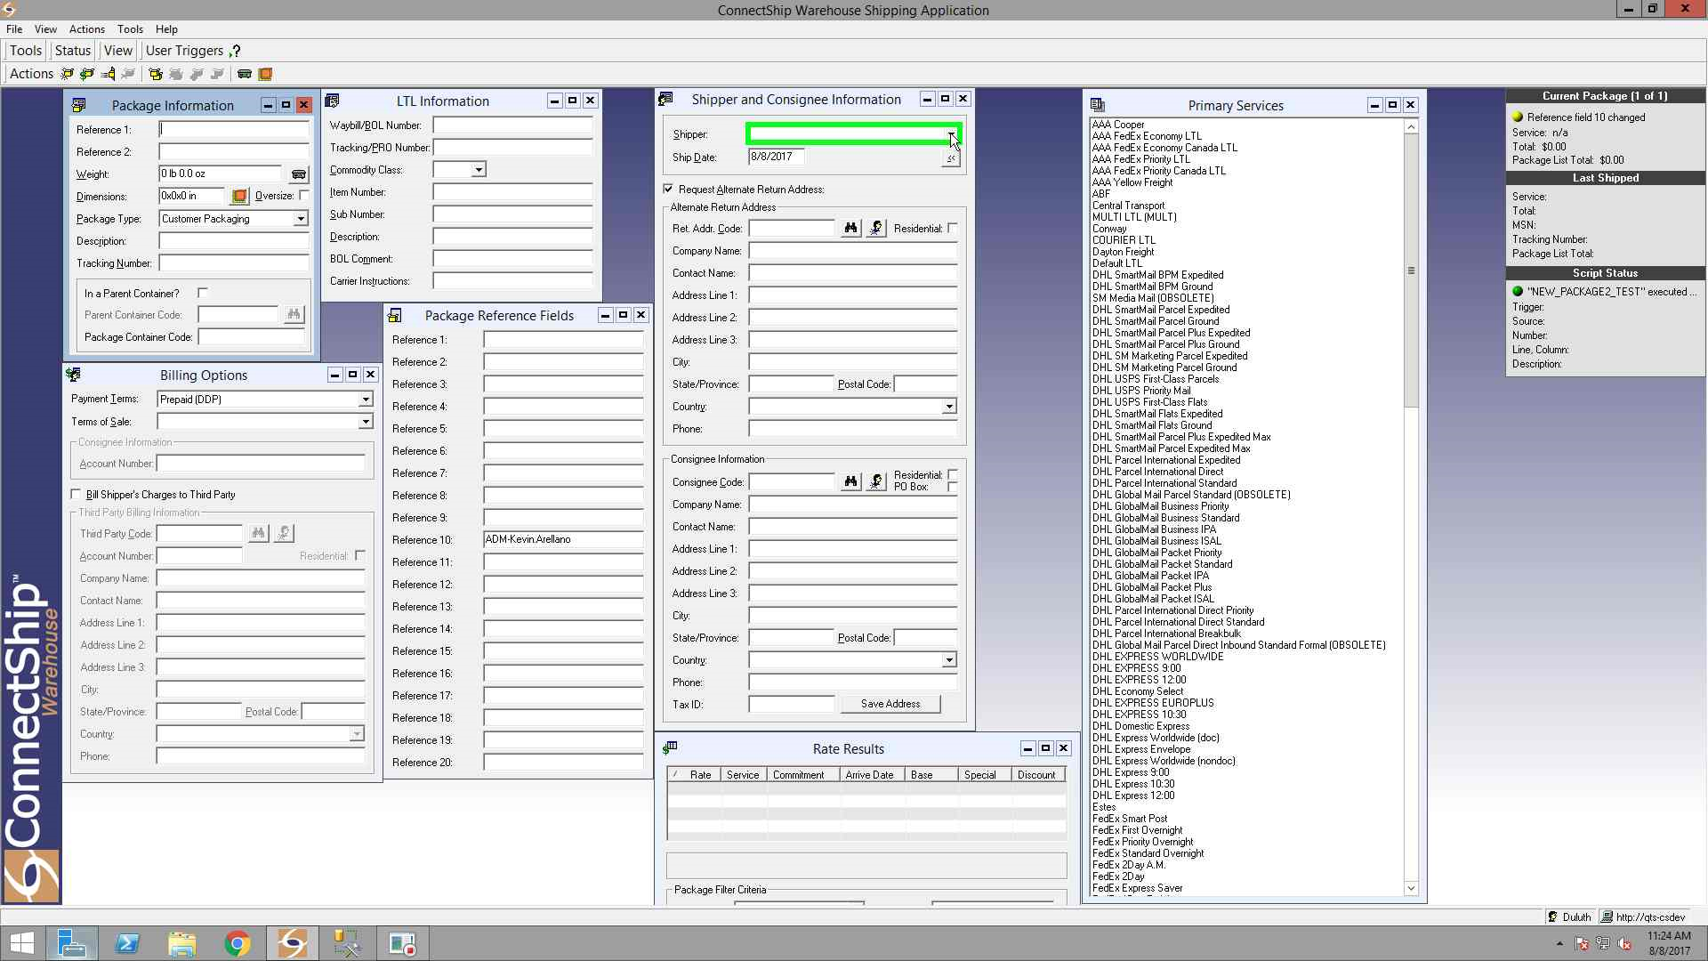

Slide 19
ConnectShip Warehouse Shipping Application
Notice how the Shipper “Wahoo (Duluth)” is not shown as listed?

Slide 20
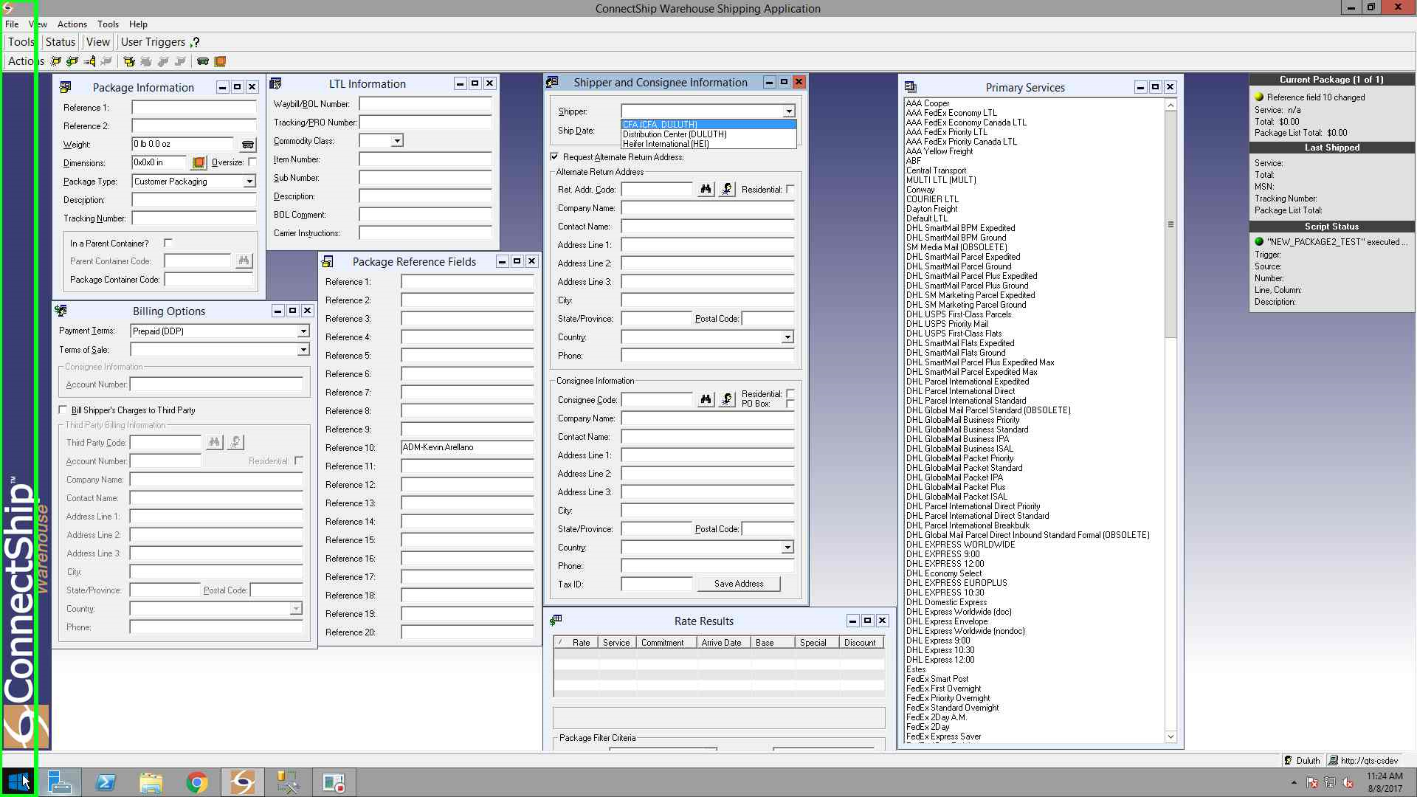

Slide 21
Windows - Start Menu
Click on the Start Menu Icon in the lower left of the screen and open Internet Explorer.

Slide 22
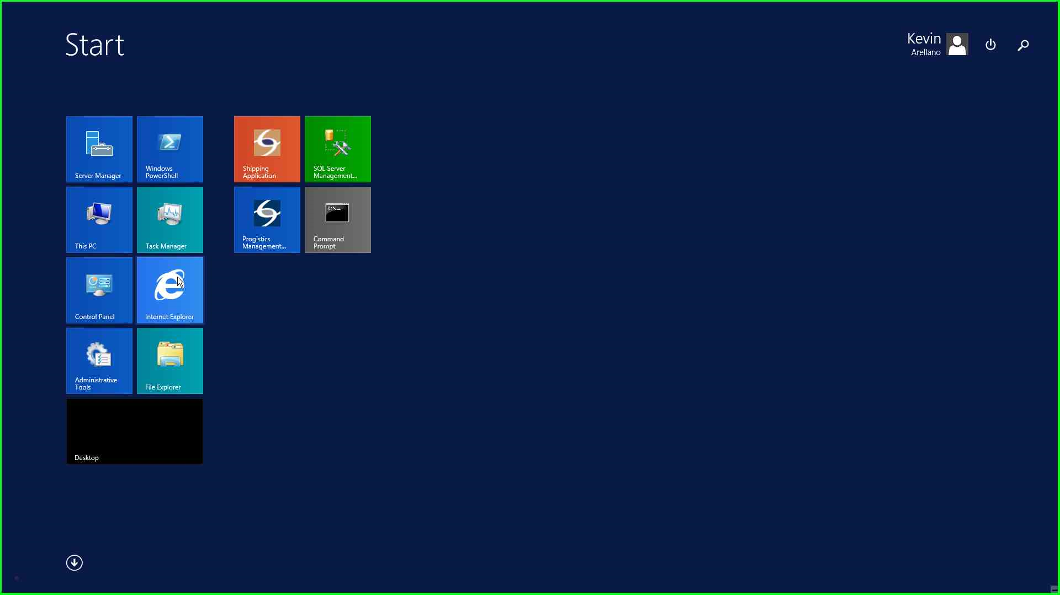

Slide 23
Internet Explorer
Go to the ConnectShip Warehouse Administrator Web Application Page.
http://qts-csdev/csw/config/login.asp
Login accordingly (this case as “Duluth”).

Slide 24
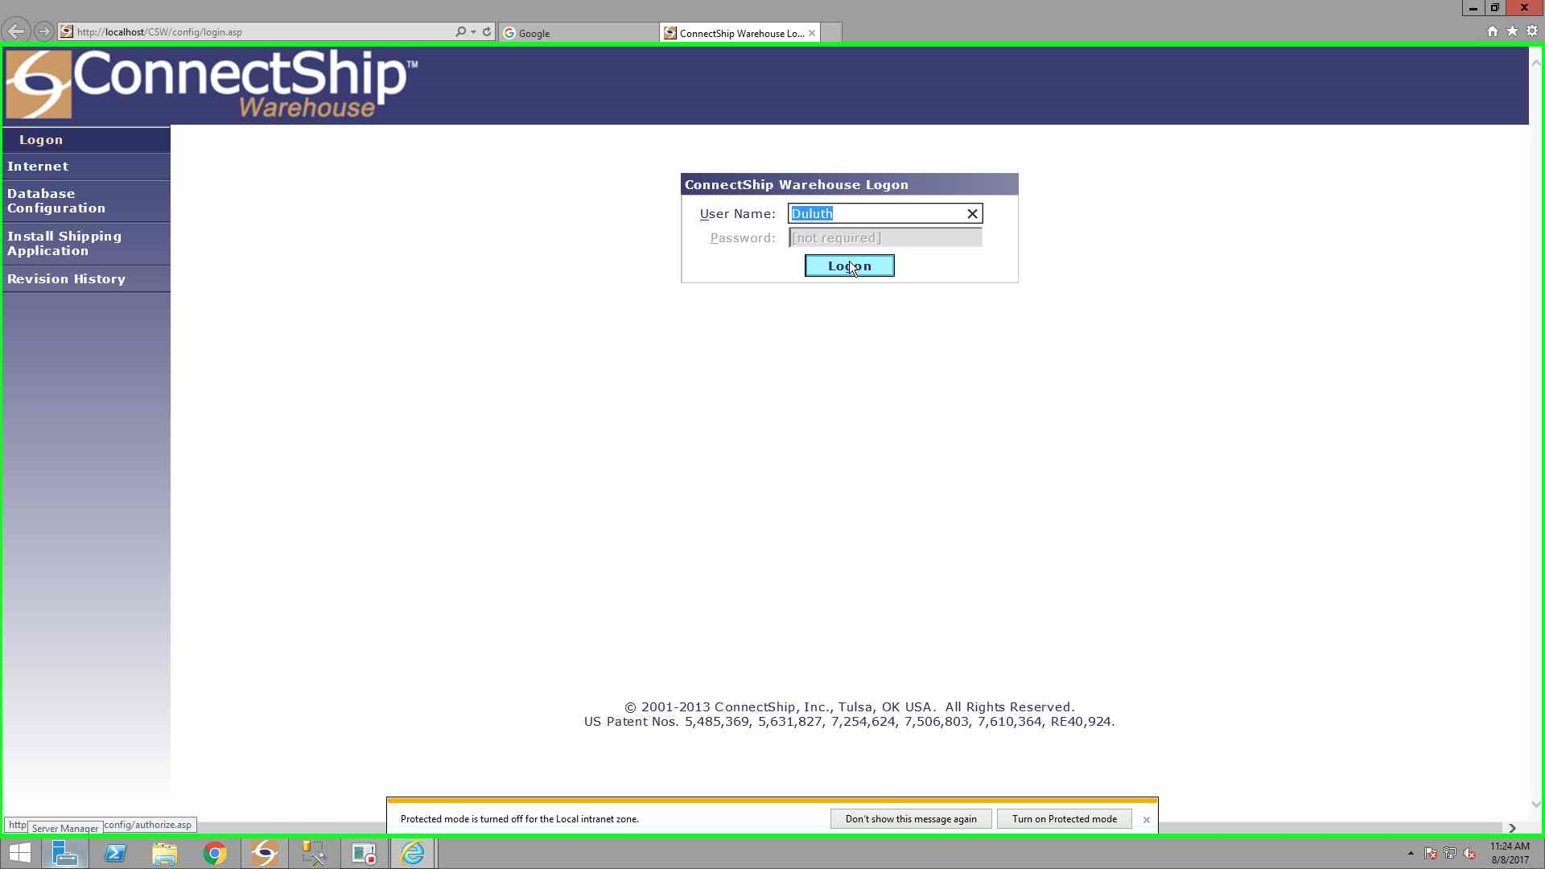

Slide 25
Internet Explorer
Click on the “Profiles” tab on the left side.

Slide 26
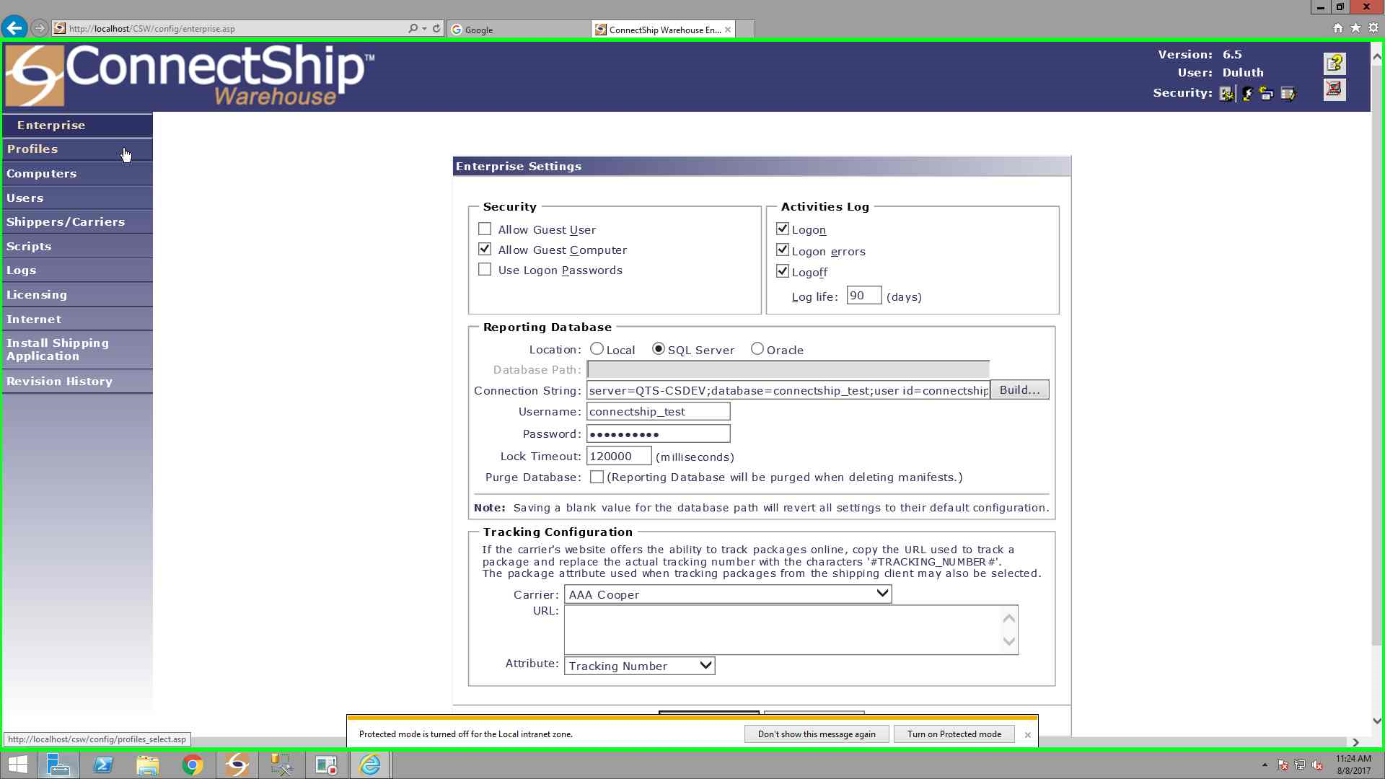

Slide 27
Internet Explorer
Select the appropriate “Profile” from the list and click on Edit.

Slide 28
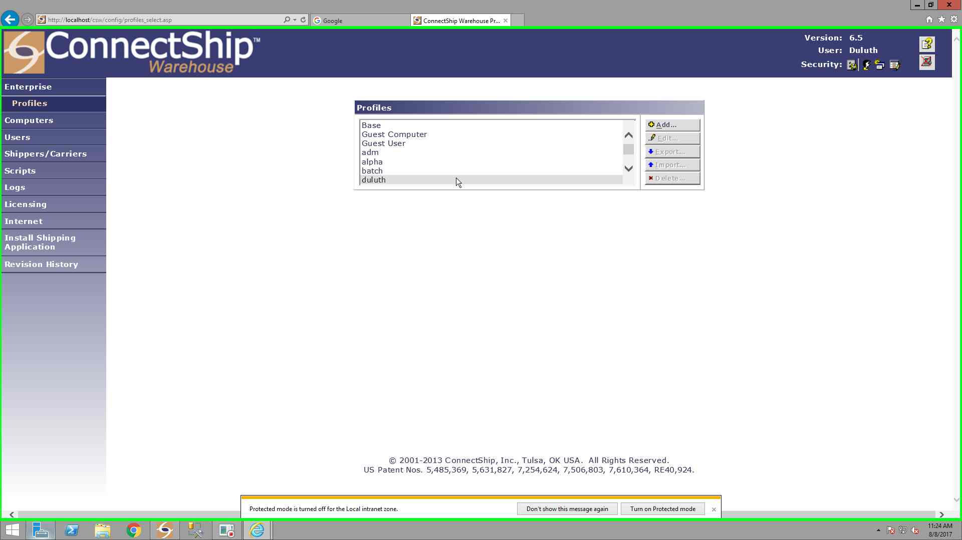

Slide 29
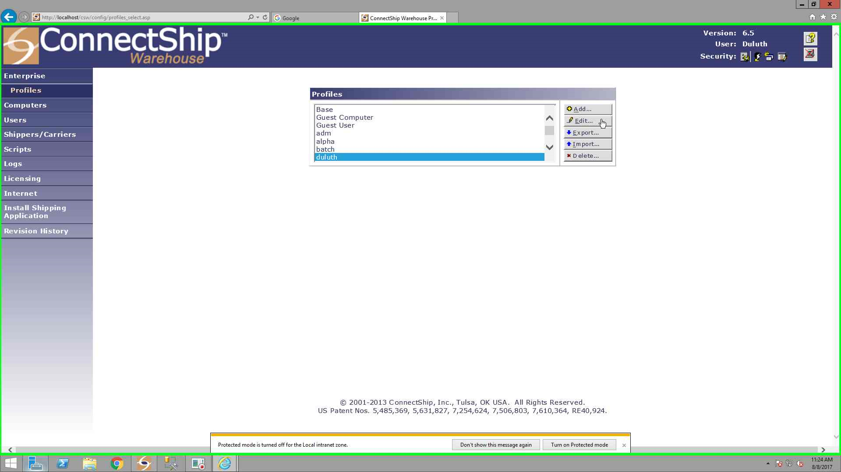

Slide 30
Internet Explorer
Under “Field Settings” sub category, click on “General Fields”

Slide 31
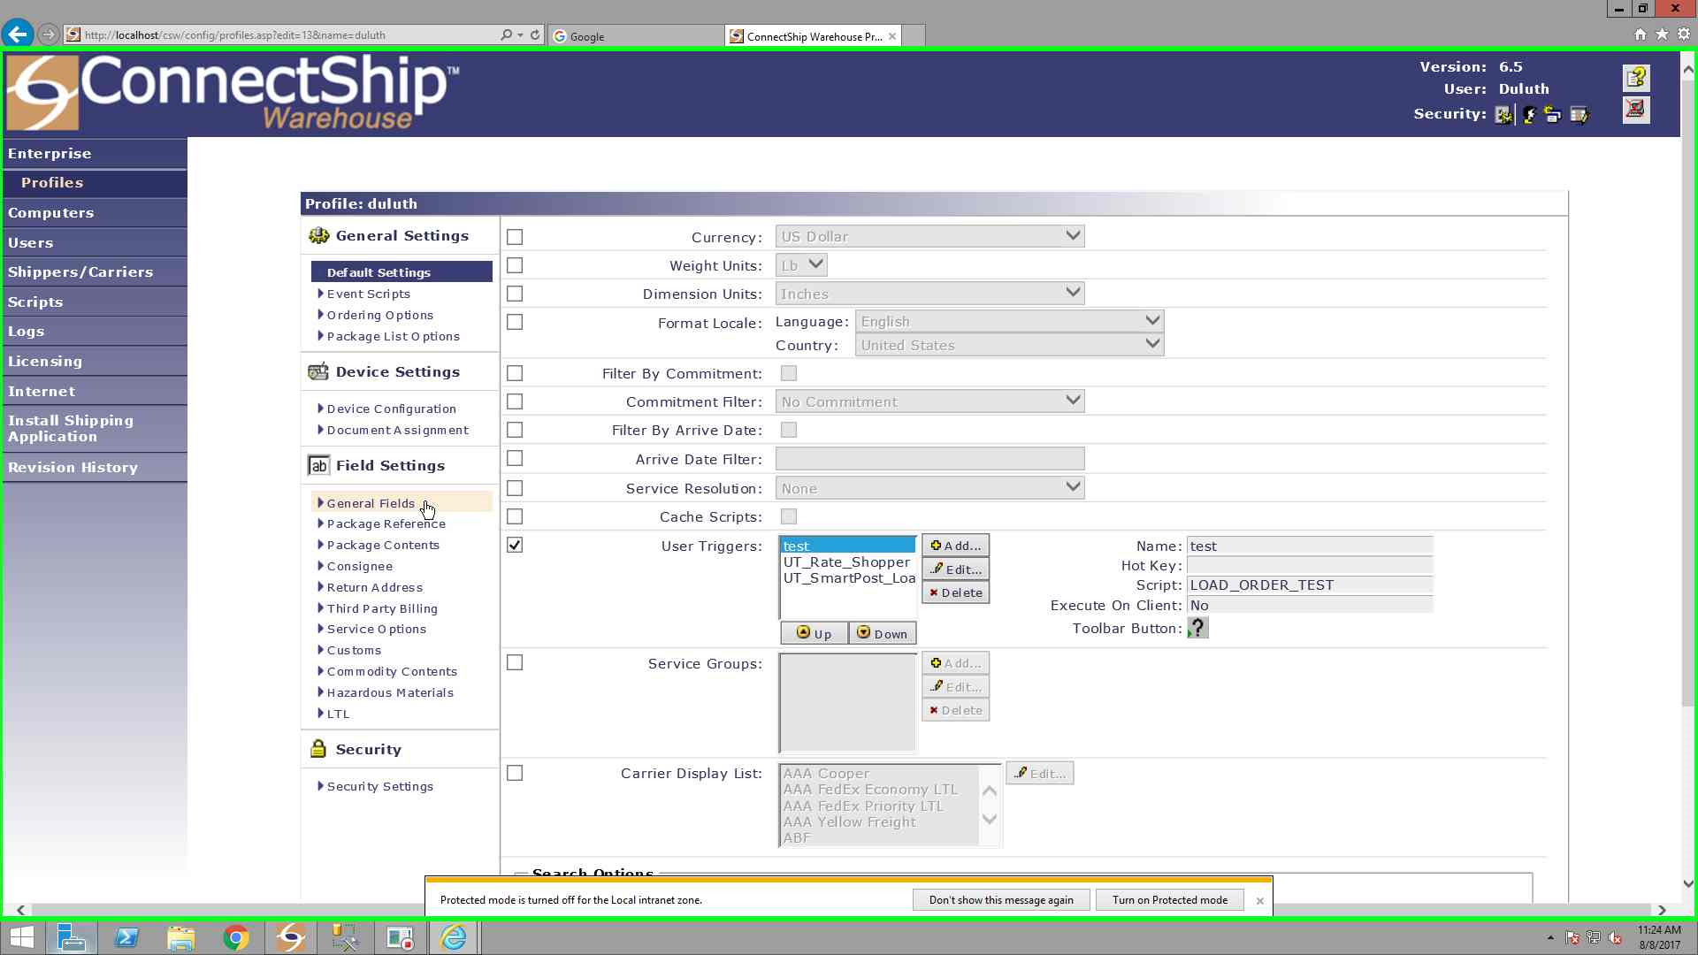

Slide 32
Internet Explorer
Click the plus box next to “Shipper” to drop down more configuration settings.

Slide 33
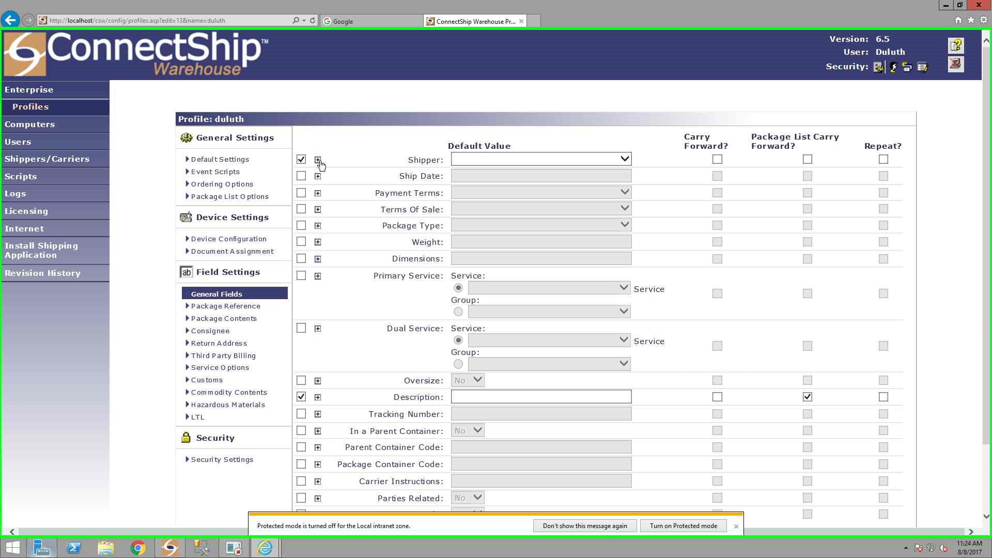

Slide 34
Internet Explorer
Under “Shipper Display List” box, you will notice a static list of shippers if configured that way.
Click on “Edit”.

Slide 35
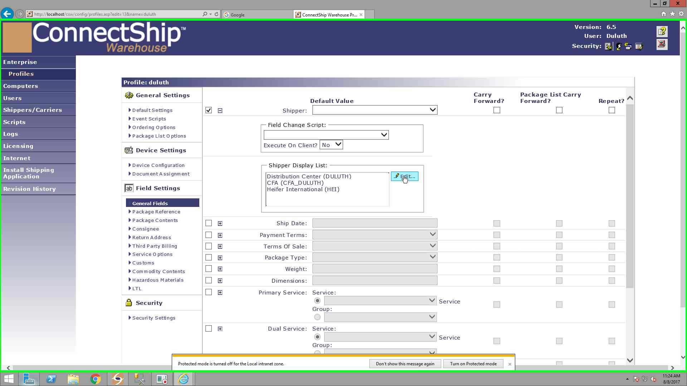

Slide 36
Internet Explorer
Under “Shipers Available:” list, select the appropriate shipper, “Wahoo (Duluth) (Wahoo)” in this case.
Click the arrow pointing right.
Click the “Save” button.

Slide 37
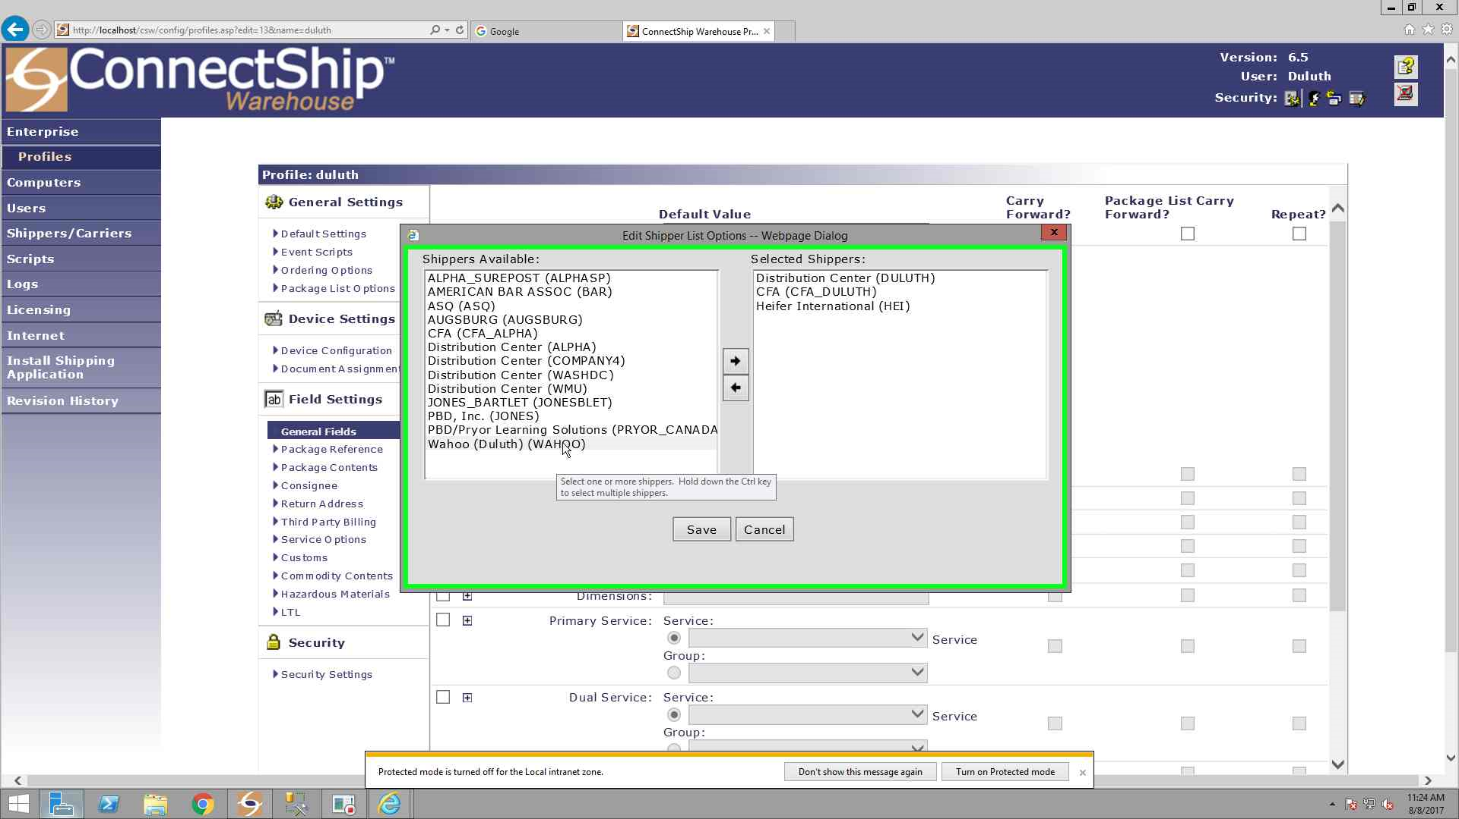

Slide 38
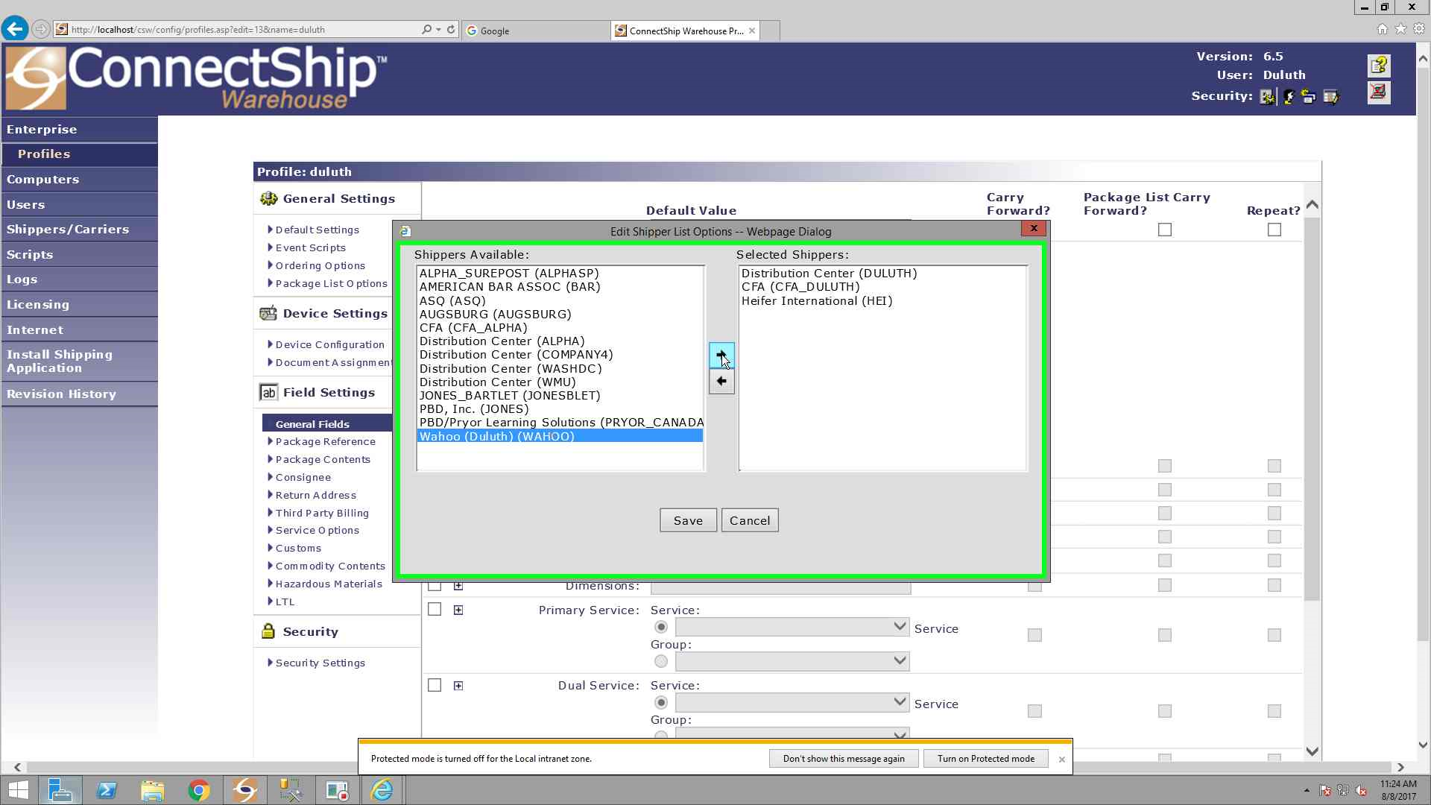

Slide 39
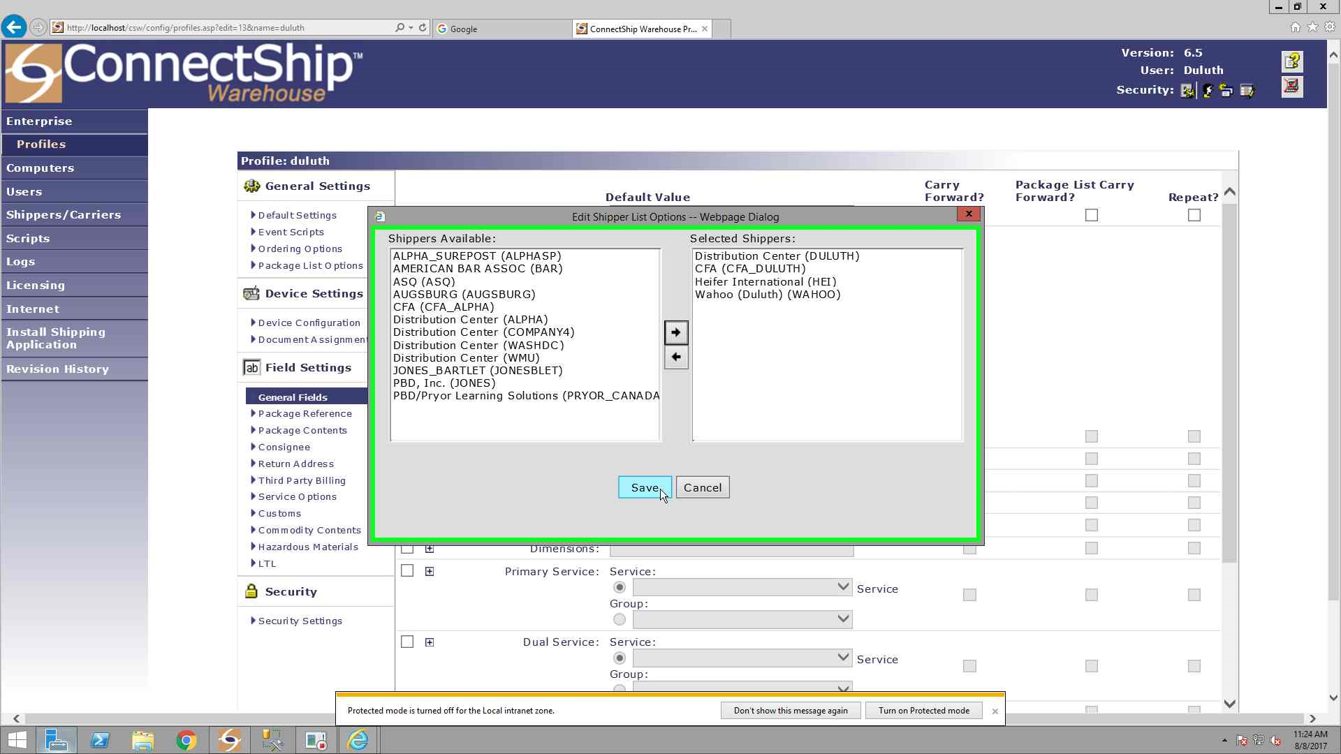

Slide 40
Internet Explorer
Notice how the new shipper, “Wahoo (Duluth) (Wahoo)” is now listed under “Shipper Display List:”

Slide 41


Slide 42
Internet Explorer
Scroll down and click the “Save” button.

Slide 43
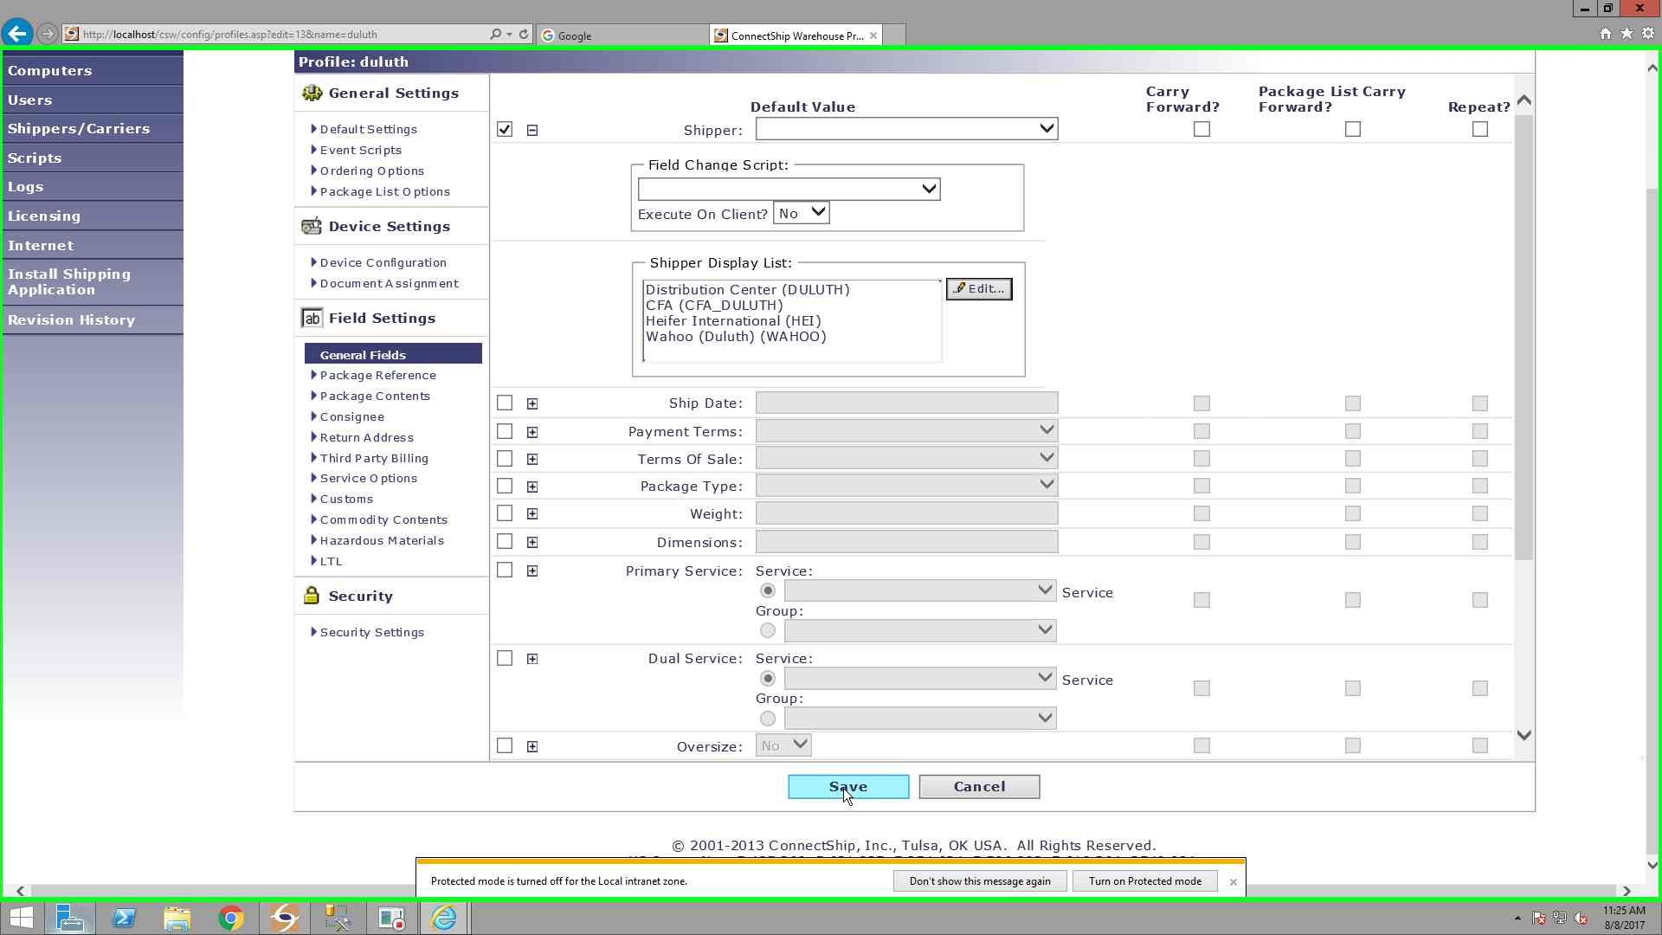

Slide 44
ConnectShip Warehouse Shipping Application
Return and restart the “ConnectShip Warehouse Shipping Application”.

Slide 45
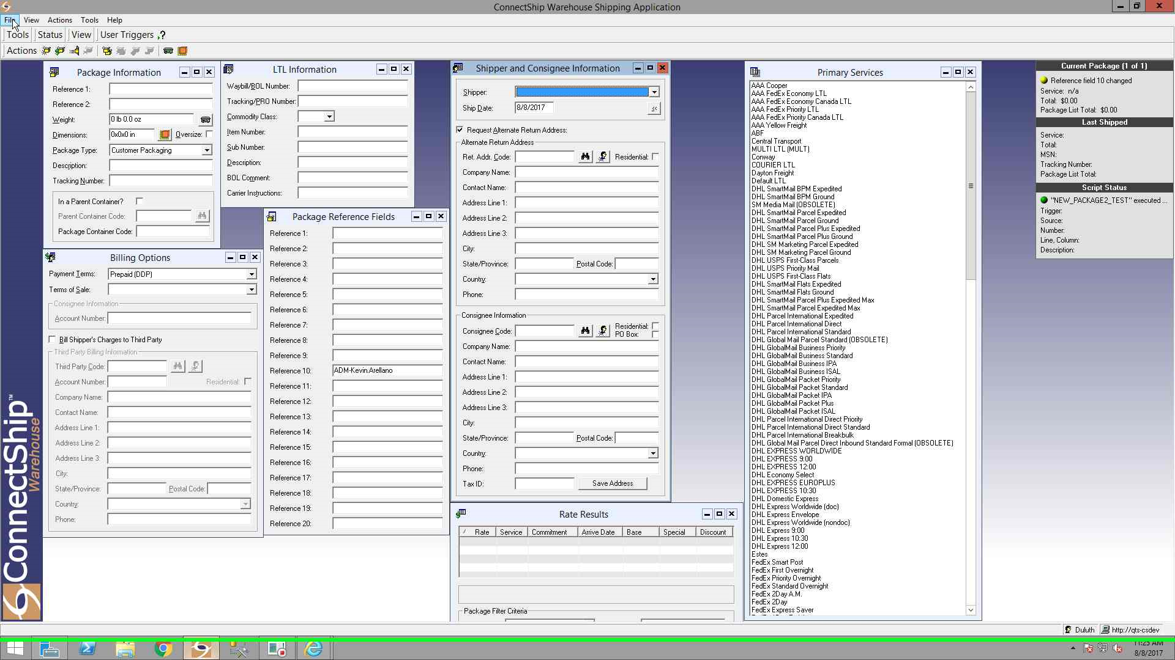

Slide 46
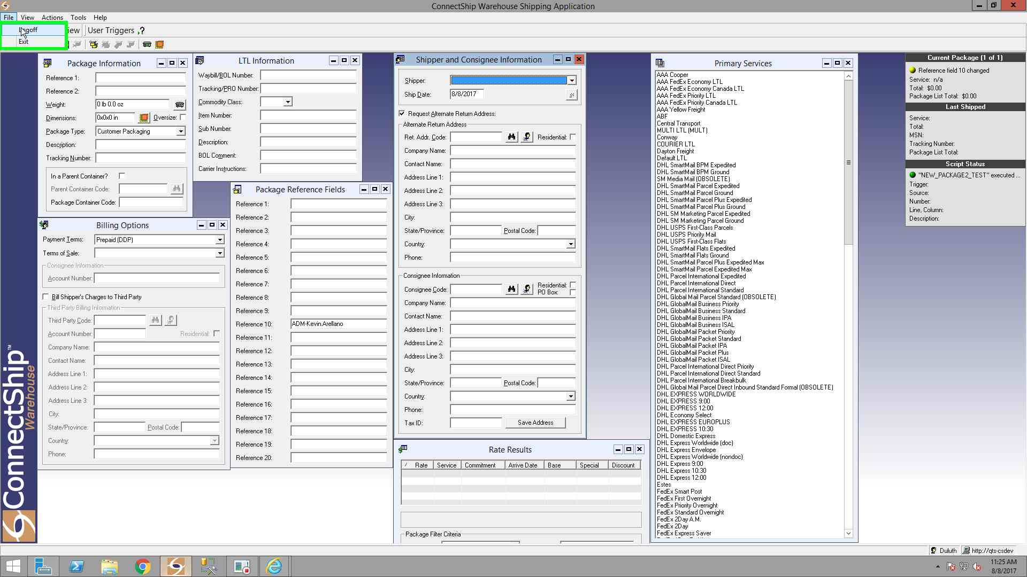

Slide 47
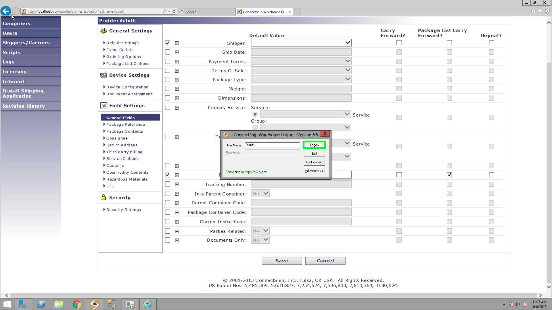

Slide 48
ConnectShip Warehouse Shipping Application
Proceed with checking again if in the “ConnectShip Warehouse Shipping Application” to see if the Shipper was added successfully.

Slide 49


Slide 50
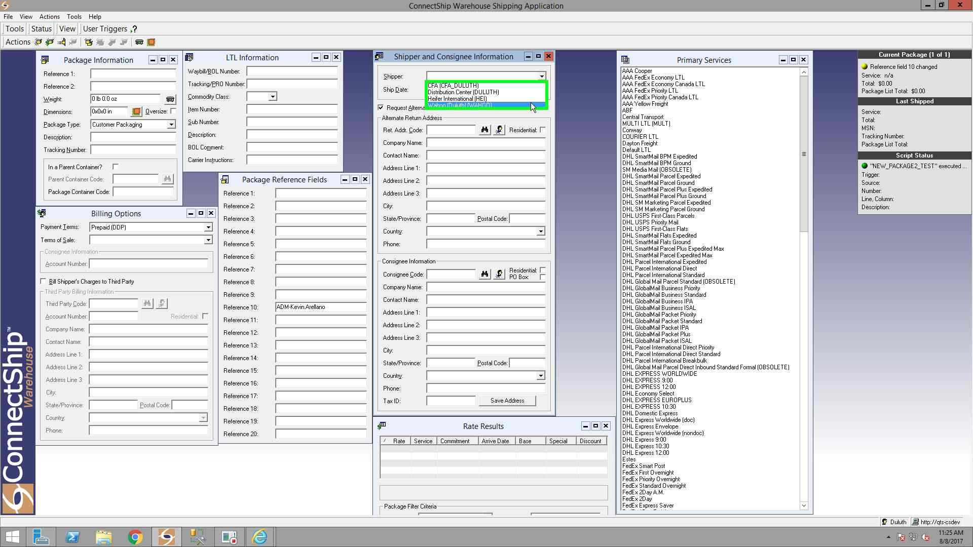

Slide 51
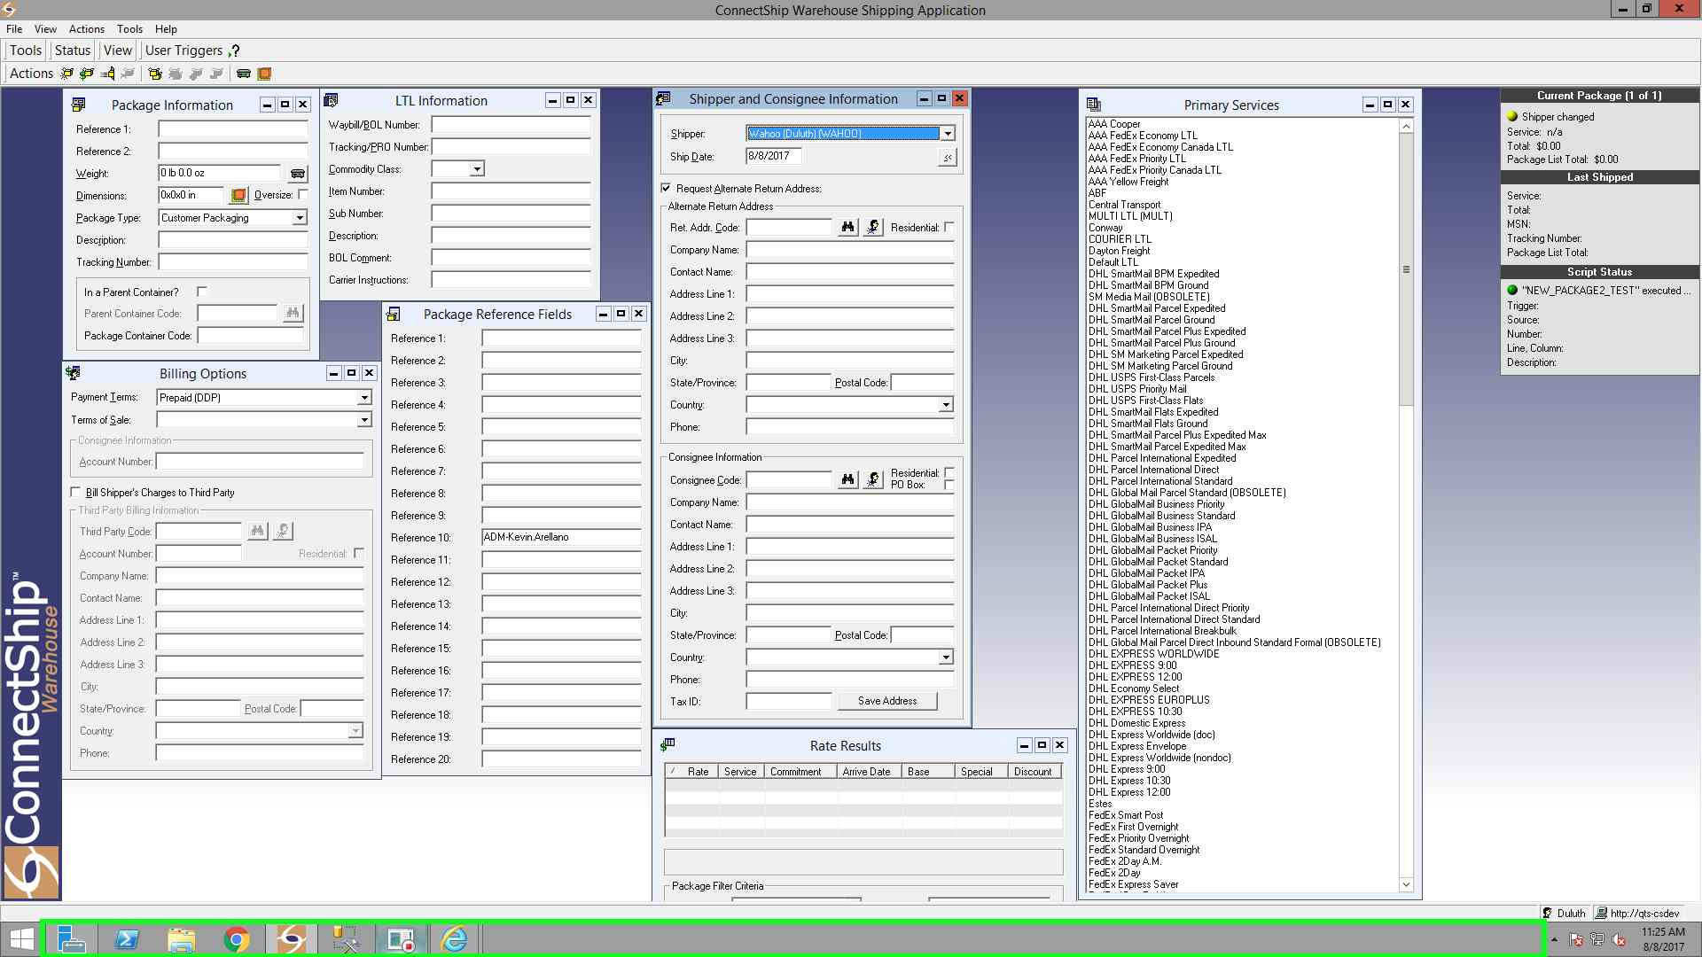

Slide 52
Adding a Shipper in ConnectShip
By: Kevin Arellano

